Slide 1
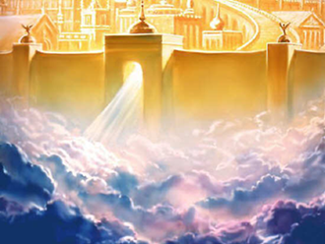
God Wants You In Heaven

Slide 2
Heaven Is a Real Place
Holy God, Heaven
“In my Father’s house are many mansions: if it were not so, I would have told you. I go to prepare a place for you.” John 14:2

Slide 3
Earth Is a Real Place
Holy God, Heaven
“He was in the world, and the world was made by him, and the world knew him not.” John 1:10
Earth

Slide 4
Holy God, Heaven
God can not allow sin in Heaven
Sinful Man
“For all have sinned and come short of the glory of God.” Romans 3:23
So, sin prevents you from entering heaven when you die.
Earth

Slide 5
“For the wages of sin is death” Romans 6:23a
Holy God, Heaven
Sinful Man
Earth

Slide 6
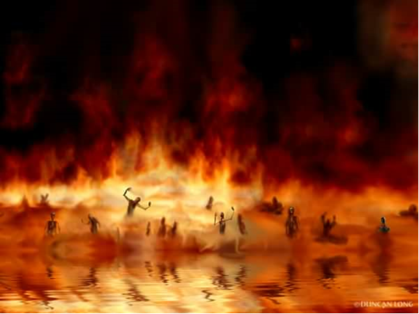
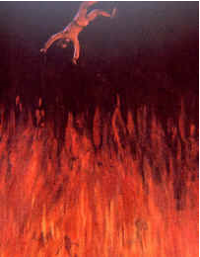
“And death and hell were cast into the lake of fire. This is the second death. And whosoever was not found written in the book of life was cast into the lake of fire.” Revelation 20:14, 15
Holy God, Heaven
Sinful Man
Earth

Slide 7
Religions of the world teach we must do something to build a bridge from earth to heaven.
Holy God, Heaven
Sinful Man
Earth

Slide 8
Does baptism help you build a bridge to heaven?
Holy God, Heaven
Sinful Man
“Not by works of righeousness which we have done, but according to his mercy he saved us…” Titus 3:5a
Be Baptized
Earth

Slide 9
Can Religion save you?
Holy God, Heaven
Sinful Man
“There is a way which seemeth right unto a man, but the end thereof are the ways of death.” Proverbs 14:12
Be Confirmed
Be Baptized
Earth

Slide 10
Eucharist
Holy God, Heaven
Sinful Man
“For he that eateth and drinketh unworthily, eateth and drinketh damnation to himself, not discerning the Lord’s body.” 1 Corinthians 11:29
Take Communion
Be Confirmed
Be Baptized
Earth

Slide 11
Holy God, Heaven
Sinful Man
“But when ye pray, use not vain repetitions…” Matthew 6:7a
Memorize Prayers
Take Communion
Be Confirmed
Be Baptized
Earth

Slide 12
Holy God, Heaven
Sinful Man
“For by grace are ye saved through faith; and that not of yourselves: it is the gift of God:” Ephesians 2:8
Give Money
Memorize Prayers
Take Communion
Be Confirmed
Be Baptized
Earth

Slide 13
Sinful Man
Holy God, Heaven
Do Good Works
“Not by works, lest any man should boast.” Ephesians 2:9
Give Money
Memorize Prayers
Take Communion
Be Confirmed
Be Baptized
Earth

Slide 14
Sinful Man
Holy God, Heaven
Follow 10 Commandments
Do Good Works
“For whosoever shall keep the whole law, and yet offend in one point, he is guilty of all.” James 2:10
Give Money
Memorize Prayers
Take Communion
Be Confirmed
Be Baptized
Earth

Slide 15
Sinful Man
Holy God, Heaven
Follow 10 Commandments
Do Good Works
Give Money
Memorize Prayers
Take Communion
Be Confirmed
Be Baptized
Earth

Slide 16
Sinful Man
Follow 10 Commandments
Do Good Works
Give Money
Memorize Prayers
Take Communion
Be Confirmed
Be Baptized
Earth

Slide 17
Sinful Man
Follow 10 Commandments
Do Good Works
Give Money
Memorize Prayers
Take Communion
Be Confirmed
Be Baptized
Earth

Slide 18
Follow 10 Commandments
Sinful Man
Do Good Works
Give Money
Memorize Prayers
Take Communion
Be Confirmed
Be Baptized
Earth

Slide 19
Follow 10 Commandments
Do Good Works
Sinful Man
Give Money
Memorize Prayers
Take Communion
Be Confirmed
Be Baptized
Earth

Slide 20
Follow 10 Commandments
Do Good Works
Give Money
Memorize Prayers
Take Communion
Be Confirmed
Be Baptized
Earth

Slide 21
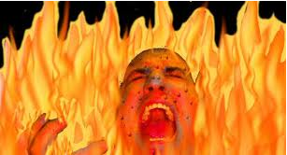
“…and the dead were judged out of those things which were written in the books, according to their works.” Revelation 20:12b
Heaven
Follow 10 Commandments
Do Good Works
“And whosoever was not found written in the book of life was cast into the lake of fire.” Rev 20:15
Give Money
Memorize Prayers
Take Communion
Be Confirmed
Be Baptized
Earth

Slide 22
Where will you be for all eternity ?

Slide 23
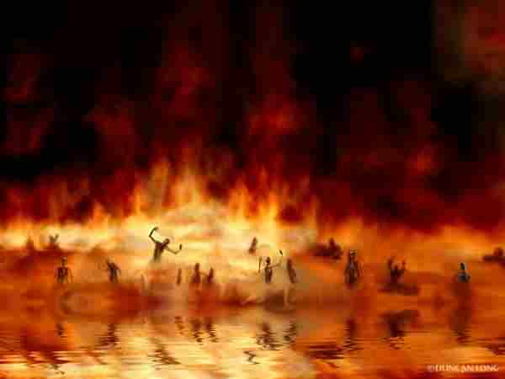
Decide now for all eternity
Heaven
or Hell

Slide 24
You Do Not Want To Go To Hell.

Slide 25
God Wants You To Go To Heaven.
For God so loved the world, that he gave his only begotten Son, that whosoever believeth in him should not perish, but have everlasting life.

Slide 26
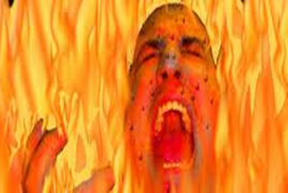
Holy God, Heaven
Religions are not your bridge to heaven.
Earth

Slide 27
Jesus Christ is Your Bridge to Heaven
Holy God, Heaven
Sinful Man
Earth

Slide 28
Jesus Christ is Your Bridge to Heaven
Holy God, Heaven
Sinful Man
Earth

Slide 29
Jesus Christ is Your Bridge to Heaven
Holy God, Heaven
Sinful Man
Earth

Slide 30
Jesus Christ is Your Bridge to Heaven
Holy God, Heaven
Forgiven man
Earth

Slide 31
Jesus Christ is Your Bridge to Heaven
Holy God, Heaven
Forgiven man
Earth

Slide 32
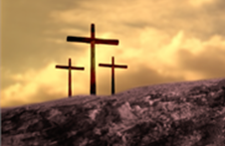
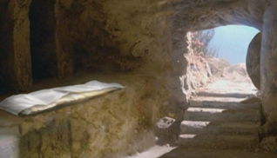
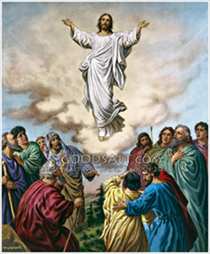
The Gospel = The Good News
Jesus Christ died for our sin.
Jesus
Christ was
Buried.
Three days later Jesus Christ
rose from the dead.

Slide 33
1 Corinthians 15:3, 4
“For I delivered unto you first of all that which I also received, how that Christ died for our sins according to the scriptures;”
“And that he was buried, and that he rose again the third day according to the scriptures:”

Slide 34
The Death of Jesus Christ
“For Christ also hath once suffered for sins, the just for the unjust, that he might bring us to God, being put to death in the flesh, but quickened by the Spirit:” 1Peter 3:18
“…and without shedding of blood is no remission.” Hebrews 9:22b

Slide 35
The Burial of Jesus Christ
“For as Jonas was three days and three nights in the whale’s belly; so shall the Son of man be three days and three nights in the heart of the earth.” Matthew 12:40
Buried 3 days proved Jesus was really dead.

Slide 36
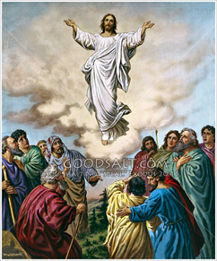
The Resurrection of Jesus Christ
“And said unto them, Thus it is written, and thus it behoved Christ to suffer, and to rise from the dead the third day:”
Luke 24:46
Resurrection proved Christ is God

Slide 37
There Are Five Things That You Must Realize To Go To Heaven

Slide 38
1. You must realize that You are lost (Going to hell)
“As it is written, There is none righteous, no, not one:”
Romans 3:10
“For all have sinned, and come short of the glory of God;”
Romans 3:23

Slide 39
2. You must realize that You are under the wrath of God
“For the wages of sin is death;” Romans 6:23a
“And the sea gave up the dead which were in it; and death and hell delivered up the dead which were in them: and they were judged every man according to their works.”
“And death and hell were cast into the lake of fire. This is the second death.”
Rev 20: 13, 14

Slide 40
3. You must realize that You cannot save yourself
“For when we were yet without strength, in due time Christ died for the ungodly.” Romans 5:6
“Knowing that a man is not justified by the works of the law, but by the faith of Jesus Christ, even we have believed in Jesus Christ, that we might be justified by the faith of Christ, and not by the works of the law: for by the works of the law shall no flesh be justified.” Galatians 2:16

Slide 41
4. You must realize that Only Jesus can save you
“But God commendeth his love toward us, in that, while we were yet sinners, Christ died for us.” Romans 5:8
“For there is one God, and one mediator between God and men, the man Christ Jesus;” 1Timothy 2:5

Slide 42
5. You must realize that You are saved by faith in Jesus
“That if thou shalt confess with thy mouth the Lord Jesus, and shalt believe in thine heart that God hath raised him from the dead, thou shalt be saved.”
“For with the heart man believeth unto righteousness; and with the mouth confession is made unto salvation.”
“For whosoever shall call upon the name of the Lord shall be saved.” Romans 10:9, 10, 13

Slide 43
Turn from your unbelief now and trust Christ as you Lord and Saviour.
You Can Be Saved Today

