Slide 2
Matthew 9:35-38 “And Jesus went about all the cities and villages, teaching in their synagogues, and preaching the gospel of the kingdom, and healing every sickness and every disease among the people.

Slide 3
36 But when he saw the multitudes, he was moved with compassion on them, because they fainted, and were scattered abroad, as sheep having no shepherd.

Slide 4
37 Then saith he unto his disciples, The harvest truly is plenteous, but the labourers are few; 38 Pray ye therefore the Lord of the harvest, that he will send forth labourers into his harvest.”

Slide 5
“All scripture is given by inspiration of God, and is profitable for doctrine, for reproof, for correction, for instruction in righteousness:
That the man of God may be
perfect (matured), thoroughly furnished unto all good works.”
2 Tim 3:16-17

Slide 6
Doctrine
- That is what is right.
Reproof
- That is what is wrong.
Correction
- That is how to get right.
Instruction in righteousness
- That is how to stay right.

Slide 7
A person said to me,
“When I pray, it seems like the heavens become as brass and the windows of heaven are nailed shut.”
“There is nothing but deadness and I get nothing from God after I have prayed.”

Slide 8
REMEMBER THESE BIBLE FACTS:
1. God commands us to pray. Isaiah 55:6
2. God hears our prayers. Psalm 65:2
3. God answers prayer. Isaiah 58:9
4. God delights in our prayers. Prov. 15:8

Slide 9
These four facts indicate that the windows of heaven are open.
However, there is another
aspect of prayer.
YOU CAN NAIL THE WINDOWS OF HEAVEN SHUT.

Slide 10
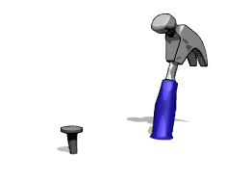
NAILING
THE WINDOWS
OF HEAVEN SHUT
Let me give you some nails that will nail
the windows of heaven shut.

Slide 11
NAIL #1
MONEY
How do you
use your money?
Malachi 3:8-10 “Will a man rob God? Yet ye have robbed me. But ye say, Wherein have we robbed thee?
In tithes and offerings. 9 Ye are cursed with a curse: for ye have robbed me, even this whole nation.

Slide 12
NAIL #1
MONEY
How do you
use your money?
10 Bring ye all the tithes into the storehouse, that there may be meat in mine house, and prove me now herewith, saith the LORD of hosts, (here is the promise, here is the blessing) if I will not open you the windows of heaven, and pour you out a blessing, that there shall not be room enough to receive it…”

Slide 13
NAIL #1
MONEY
How do you
use your money?
It is your choice, a blessing or a curse.
Luke 6:38 “Give, and it shall be given unto you; good measure, pressed down, and shaken together, and running over, shall men give into your bosom. For with the same measure that ye mete withal it shall be measured to you again.”
; Prov. 3:9-10;
1 Cor. 16:1-2; Mat. 6:33

Slide 14
NAIL #1
MONEY
How do you
use your money?
It is your choice, a blessing or a curse.
Prov. 3:9-10 “Honour the LORD with thy substance, and with the firstfruits of all thine increase: So shall thy barns be filled with plenty, and thy presses shall burst out with new wine.”

Slide 15
NAIL #1
MONEY
How do you
use your money?
It is your choice, a blessing or a curse.
1 Cor. 16:1-2 “Now concerning the collection for the saints, as I have given order to the churches of Galatia, even so do ye. 2 Upon the first day of the week let every one of you lay by him in store, as God hath prospered him, that there be no gatherings when I come.”

Slide 16
NAIL #1
MONEY
How do you
use your money?
It is your choice, a blessing or a curse.
Mat. 6:33 “But seek ye first the kingdom of God, and his righteousness; and all these things shall be added unto you.”
Food
Shelter
Water
Clothing

Slide 17
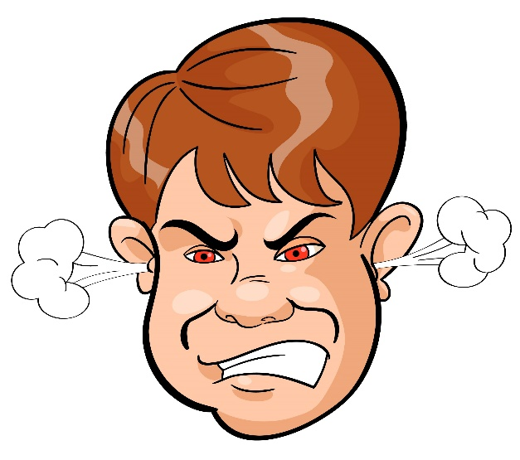
NAIL #2
DOMESTIC MATTERS.
1 Peter 3:7 “Likewise, ye husbands,
dwell with them according to
knowledge, giving honour unto the wife,
as unto the weaker vessel, and as being heirs together of the grace of life; that your prayers be not hindered.” (Eph. 5:21-6:4)

Slide 18
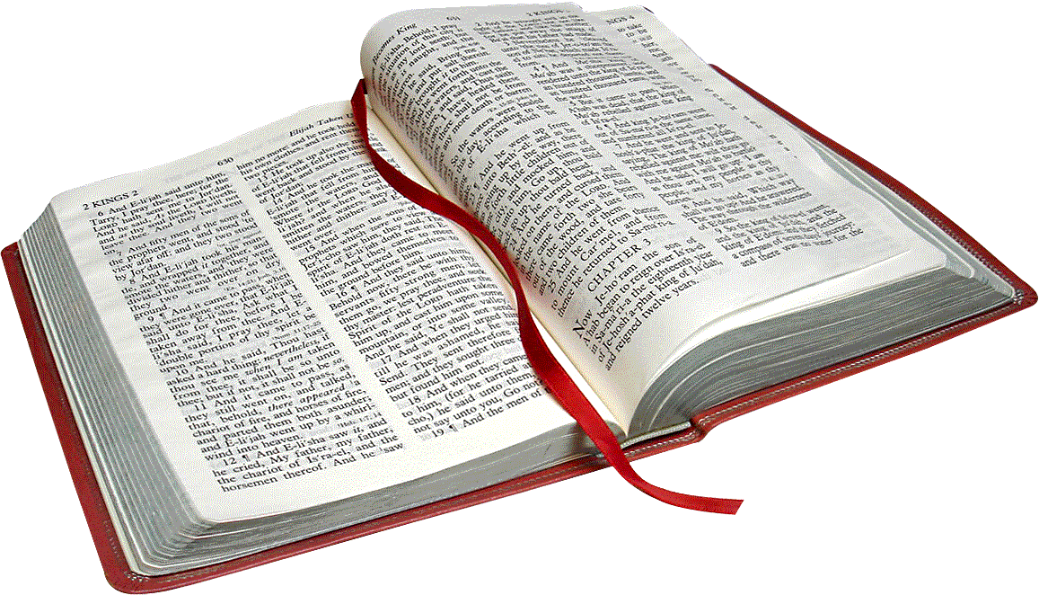
The greatest knowledge in all the world is to know the will of God.
The greatest act in all the world is to do the will of God.
Reading and Studying God’s Word
NAIL #3
DISOBEDIENCE TO
THE WORD OF GOD

Slide 19
DISOBEDIENCE TO
THE WORD OF GOD
NAIL #3
Proverbs 28:9 “He that turneth away
his ear from hearing the law, even his
prayer shall be abomination.”
1 John 3:22 “And whatsoever we ask, we receive of him, because we keep his commandments, and do those things that are pleasing in his sight.”

Slide 20
DISOBEDIENCE TO
THE WORD OF GOD
NAIL #3
2 Timothy 2:19 “…Let every one that
nameth the name of Christ depart
from iniquity.”
1 Thess. 5:22 “Abstain from all appearance of evil.”
2 Timothy 2:22 “Flee also youthful lusts: but follow righteousness, faith, charity, peace…”

Slide 21
UNCONFESSED SIN
NAIL #4
There are two Kinds of SIN
COMMISSION - doing what I should not do.
OMISSION - not doing what I should do.

Slide 22
UNCONFESSED SIN
NAIL #4
SIN IS ANYTHING THAT DISPLEASES GOD.
Psalm 66:18 “If I regard iniquity in my heart, the Lord will not hear me:”
Isaiah 1:15 “And when ye spread forth your hands, I will hide mine eyes from you: yea, when ye make many prayers, I will not hear...”

Slide 23
UNCONFESSED SIN
NAIL #4
Proverbs 28:13 “He that covereth his sins shall not prosper: but whoso confesseth and forsaketh them shall have mercy.”
1 John 1:9 “If we confess our sins, he (Jesus) is faithful and just to forgive us our sins, and to cleanse us from all unrighteousness.”

Slide 24
NAIL #5
UNBELIEF
Hebrews 11:6 “But without faith it is impossible to please him: for he that cometh to God must believe that he is, and that he is a rewarder of them that diligently seek him.”
FAITH is believing what GOD says.

Slide 25
NAIL #5
UNBELIEF
Psalm 37:4-5 “Delight thyself also in the LORD; and he shall give thee the desires of thine heart. Commit thy way unto the LORD; trust also in him; and he shall bring it to pass.”

Slide 26
NAIL #5
UNBELIEF
1 John 5:14-15 “And this is the confidence that we have in him, that, if we ask any thing according to his will, he heareth us: And if we know that he hear us, whatsoever we ask, we know that we have the petitions that we desired of him.”

Slide 27
NAIL #6
AN UNFORGIVING SPIRIT
#1. The problem is, we get offended by someone and malice sets in.
Having Malice, means having ill
or bad feeling towards someone.

Slide 28
NAIL #6
AN UNFORGIVING SPIRIT
Colossians 3:8 “But now ye also put off all these; anger, wrath, malice, blasphemy, filthy communication out of your mouth.”

Slide 29
NAIL #6
AN UNFORGIVING SPIRIT
1. When we have malice in our heart:
We can’t hear the Pastor’s message
because our focus is on the hurt.
We spread our malice to our family and to others.

Slide 30
NAIL #6
AN UNFORGIVING SPIRIT
1. When we have malice in our heart:
We become a prisoner and focus on our hurt. We are in bondage.
Malice will effect your health.

Slide 31
NAIL #6
AN UNFORGIVING SPIRIT
#2. The Solution to this malice is, we are to forgive those who have offended us.
Jesus said in Matthew 6:14 “For if ye forgive men their trespasses, your heavenly Father will also forgive you.”

Slide 32
NAIL #6
AN UNFORGIVING SPIRIT
#3. A warning is given, if we do not forgive:
Jesus said in Matthew 6:15 “But if ye forgive not men their trespasses, neither will your Father forgive your trespasses.”

Slide 33
NAIL #6
AN UNFORGIVING SPIRIT
It is very important that we forgive others because we need forgiveness from God daily for our own sins.
If we do not forgive others then God will not forgive us.
That is very dangerous because
we need to be forgiven daily.

Slide 34
NAIL #6
AN UNFORGIVING SPIRIT
1. The problem - we get offended.
2. The solution - forgive the offender.
3. The warning – if you don’t forgive others then God will not forgive you.
What you sow you will also reap
more than you sow.

Slide 35
#4. HOW DO WE DO THIS?
Jesus said in Matthew 5:23-24 “Therefore if thou bring thy gift to the altar, (when you pray) and there rememberest that thy brother (anybody) hath ought against thee; 24 Leave there thy gift before the altar, (stop praying) and go thy way; first be reconciled to thy brother, and then come and offer thy gift.” (go back home and continue to pray)

Slide 36
What does this verse tell us to do?
You are to go to that person who has offended you (or you have offended them) and say, “I have offended you and it has brought bad feelings between us. Will you please forgive me for offending you?”

Slide 37
Even when a person has offended you, it causes you to have bad feelings (malice) towards the offender. Go to them, never accuse them but ask them to forgive you. Wait for those needed words, “Yes, I forgive you.”
When you do this then God is pleased and fellowship is restored.

Slide 38
#5. Christ is our Example
Ephesians 4:27-32 “Neither give place to the devil.....29 Let no corrupt communication proceed out of your mouth, but that which is good to the use of edifying, that it may minister grace unto the hearers. 30 And grieve not the holy Spirit of God, whereby ye are sealed unto the day of redemption.

Slide 39
#6. How often are we to forgive?
Matthew 18:21-22 Then came Peter to him, and said, Lord, how oft shall my brother sin against me, and I forgive him? till seven times? 22 Jesus saith unto him, I say not unto thee, Until seven times: but, Until seventy times seven. (490 times a day)

Slide 40
#7. How should we forgive others?
Like Jesus. Matt. 18:15-17
Right away. Don’t put it off.
It will eat you up if you delay.
Privately or publicly?

Slide 41
Six nails that will nail shut the windows of Heaven:
1. Money - the misuse of it.
2. Domestic problems.
3. Disobedience to the Word of God.

Slide 42
4. Unconfessed sins in our lives,
commission or omission
5. Unbelief
6. An unforgiving spirit.
Let us pull those nails out.

Slide 43
NAIL #7 This nail will nail THE DOOR of Heaven shut forever
if you reject Jesus Christ
as your Lord and Savior.
“Except a man be born again, he cannot see the kingdom of God.” John 3:3
“Believe on the Lord Jesus Christ, and thou shalt be saved…” Acts 16:31

Slide 44
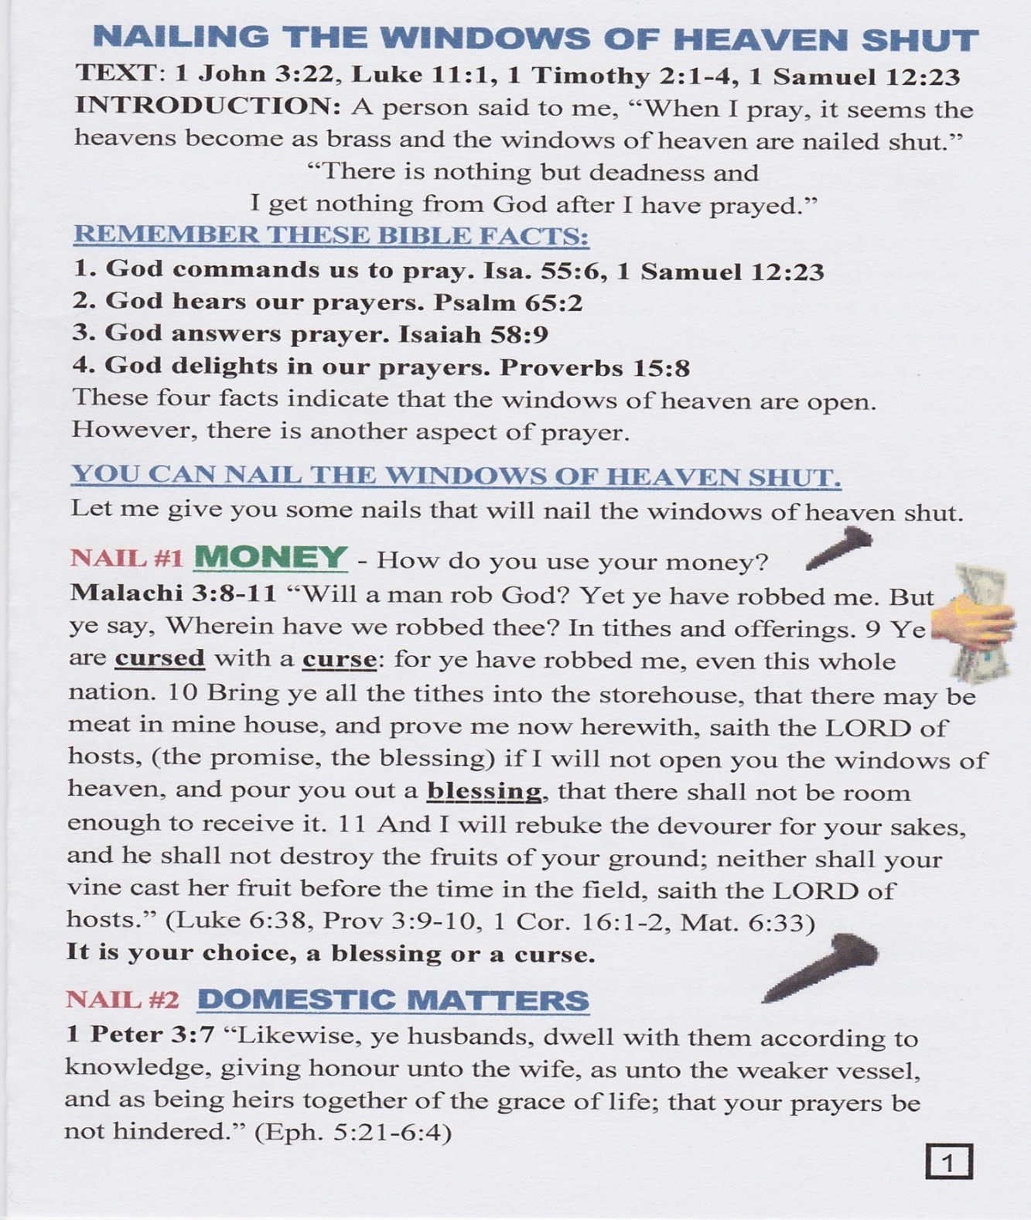
YOU WILL BE RECEIVING
THIS STUDY GUILD AS YOU LEAVE. PLEASE STUDY IT. IT WILL HELP YOU.

